Slide 1

Databases & Data Warehouses

Slide 2
Outline
Database Concepts
  Steps in Database Design
  Entity-Relationship Model
  Logical Database Design
    Relational Model
    Object-Relational Model
  Physical Database Design
Data Warehouse Concepts
  Logical Data Warehouse Design
  Physical Data Warehouse Design
  Data Warehouse Architecture

Slide 3
Steps in Database Design
Requirements specification: Collects information about users’ needs with respect to the database system
Conceptual design: Builds a user-oriented representation of the database without any implementation considerations
Logical design: Translates the conceptual schema from the previous phase into an implementation model common to several DBMSs, e.g., relational or object-relational
Physical design: Customizes the logical schema from the previous phase to a particular platform, e.g., Oracle or SQL Server

Slide 4
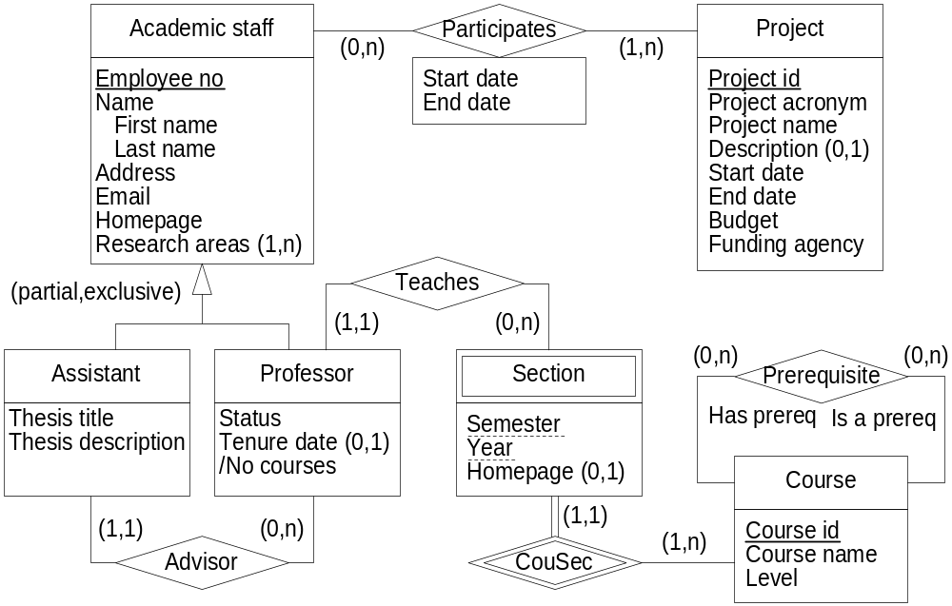
Entity Relationship Model: University Example

Slide 5
ER Model: Entity and Relationship Types
Entity Relationship Model: Most often used conceptual model for database design
Entity type: Represents a set of real-world objects of interest to an application
  Entity: object belonging to an entity type
Relationship type: Represents an association between objects
  Relationship: association belonging to a relationship type
Role: Participation of an entity type in a relationship type
Cardinalities in a role: Minimum and maximum number of times that the entity may participate in the relationship type

Slide 6
ER Model: Entity and Relationship Types
Types of roles
  Optional vs mandatory: minimum cardinality 0 vs 1
  Monovalued vs multivalued: maximum cardinality 1 vs n
Relationship types
  Binary vs n-ary: two vs more than two participating entity types
Binary relationship types:
  One-to-one, one-to-many, or many-to-many depending on the maximum cardinality of the two roles
Recursive relationship types: the same entity type participates more than once in the relationship type
  Role names are then necessary to distinguish different roles

Slide 7
ER Model: Attributes
Attributes: Structural characteristics describing objects and relationships
Attributes have cardinalities, as for roles
Depending on cardinalities, attributes may be
  Optional vs mandatory
  Monovalued vs multivalued
Complex attributes: Attributes composed of other attributes
Derived attributes: Their value for each instance may be calculated from other elements of the schema

Slide 8
ER Model: Identifiers and Weak Entity Types
Identifier or key: One or several attributes that uniquely identify a particular object
Weak entity type: Do not have identifier of their own
  Regular entity types are called strong entity types
A weak entity type is dependent on the existence of another entity type, called the identifying or owner entity type
An identifying relationship type relates a weak entity type to its owner
  Normal relationship types are called regular relationship types
Partial key: Set of attributes that can uniquely identify weak entities related to the same owner entity

Slide 9
ER Model: Generalization
Generalization or is-a relationship: Relates perspectives of the same concept at different abstraction levels
  Supertype: Entity at higher abstraction level
  Subtype: Entity at lower abstraction level
Population inclusion: Every instance of the subtype is also an instance of the supertype
Inheritance: All characteristics (e.g., attributes, roles) of the supertype are inherited by the subtype
Substitutability: Each time an instance of a supertype is required, an instance of the subtype can be used instead

Slide 10
ER Model: Generalization
Several generalization relationships accounting for the same criterion can be grouped
Types of generalizations
  Total vs partial: depending on whether every instance of the supertype is also an instance of one of the subtypes
  Disjoint vs overlapping: depending on whether an instance may belong to one or several subtypes
Multiple inheritance: A subtype that has several supertypes
  May induce conflicts when a property of the same name is inherited from two supertypes

Slide 11
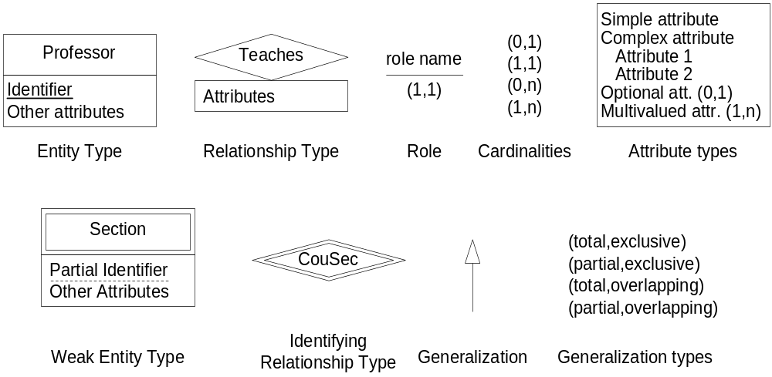
ER Model: Summary of Notation

Slide 12
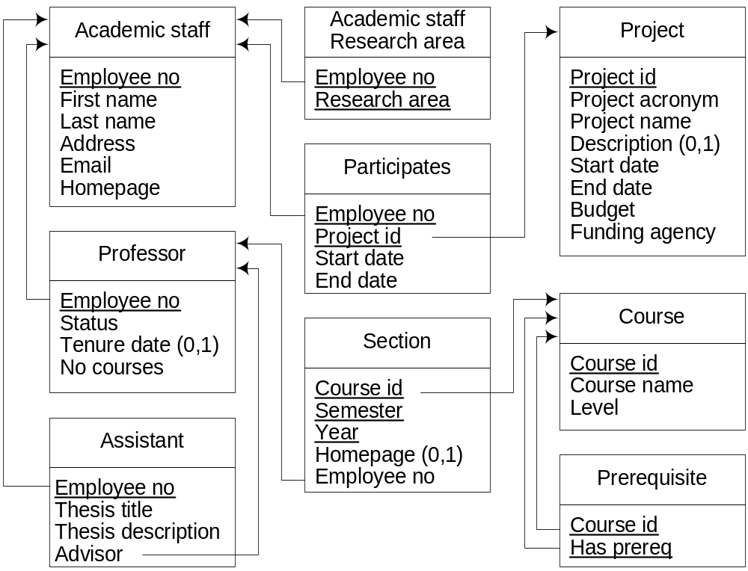
Relational Model: University Example

Slide 13
Relational Model
Based on a simple data structure
  A relation or table, composed of attributes or columns
Each attribute is defined over a domain or data type
  Typical domains: integer, float, date, string, …
Tuple or row: element of the table
Provides several declarative integrity constraints
Not null attribute: a value for the attribute must be provided
Key: column(s) that uniquely identify one row of the table
  Simple vs composite key: depending on whether key is composed of one or several columns
  Primary vs alternate key: one of the keys must be chosen as primary by the designer, the others are alternate keys

Slide 14
Relational Model
Referential integrity
  Defines a link between two tables (or twice the same one)
  A set of attributes in one table (foreign key) references the primary key of the other table
  Values in the foreign key columns must also exist in the primary key of the referenced table
Check constraint: defines a predicate that must be valid when inserting or updating a tuple in a relation
  Predicate can only involve the tuple being inserted/deleted
All other constraints must be expressed by triggers: an event-condition-action rule that is automatically activated when a relation is updated

Slide 15
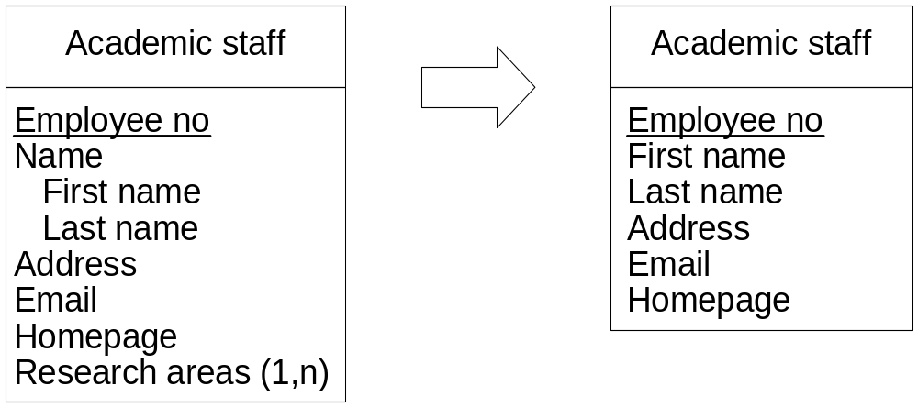
Translating from ER to Relational Schemas
Rule 1: A strong entity type is associated with a table
  Table contains the simple monovalued attributes and the simple component of the monovalued complex attributes of the entity type
  Table also defines not null constraints for mandatory attributes
  Identifier of the entity type define the primary key of the table

Slide 16
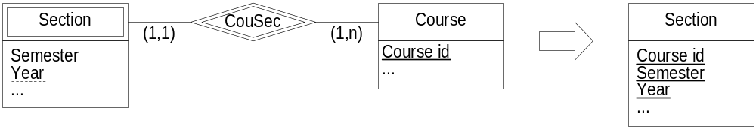
Translating from ER to Relational Schemas
Rule 2: A weak entity type is transformed as a strong entity type, but the associated table also contains the identifier of the owner entity
  A referential integrity constraint relates this identifier to the table associated with the owner entity type
  Primary key of the table: partial identifier of the weak entity type + identifier of the owner entity type

Slide 17
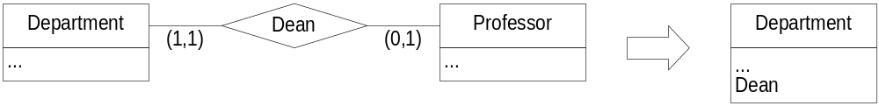
Translating from ER to Relational Schemas
Rule 3: A binary one-to-one relationship type is represented by including the identifier of one of the participating entity types in the table associated to the other entity type
  A referential integrity constraint relates this identifier to the table associated with the corresponding entity type
  Simple monovalued attributes and simple components of monovalued complex attributes are also included in the table
  Not null constraint for mandatory attributes are also defined

Slide 18
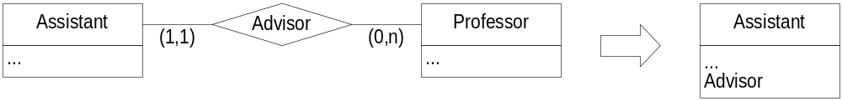
Translating from ER to Relational Schemas
Rule 4: A binary one-to-many relationship type is represented by including the identifier of the entity type with cardinality 1 in the table associated to the other entity type
  A corresponding referential integrity constraint is added
  Attributes and not null constraints are also added as in previous rules

Slide 19
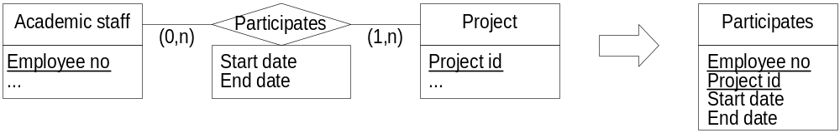
Translating from ER to Relational Schemas
Rule 5: A binary many-to-many relationship type or an n-ary relationship type is associated with a table containing the identifiers of the entity types that participate in all its roles
  Corresponding referential integrity constraints are added
  Attributes and not null constraints are also added as in previous rules
  Identifier if any is the key of the relation, but the combination of all role identifiers can be used as a key

Slide 20
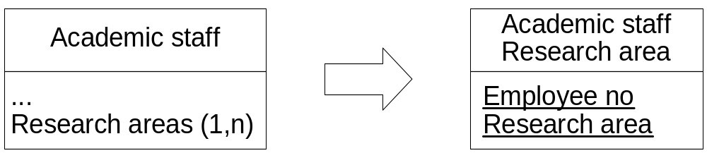
Translating from ER to Relational Schemas
Rule 6: A multivalued attribute is associated with a table containing the identifier of the entity or relationship type to which it belongs
  Corresponding referential integrity constraint is added
  Primary key of table is composed of all its attributes

Slide 21
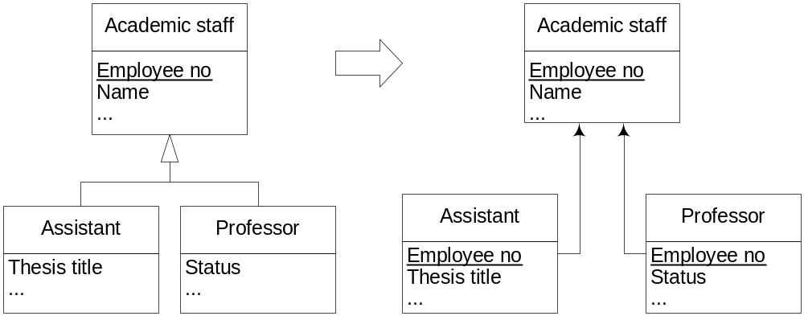
Translating from ER to Relational Schemas
Rule 7: A generalization can be translated in 3 ways
  The supertype and the subtype are associated with tables containing the identifier of the entity type. There is a referential integrity constraint from the table of the subtype to the table of the subtype

Slide 22
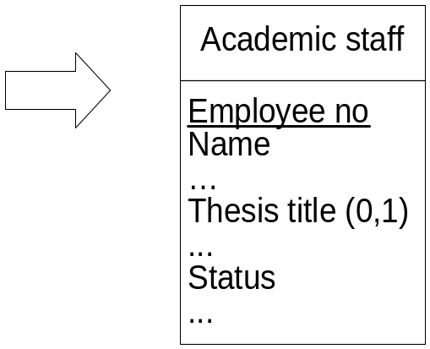
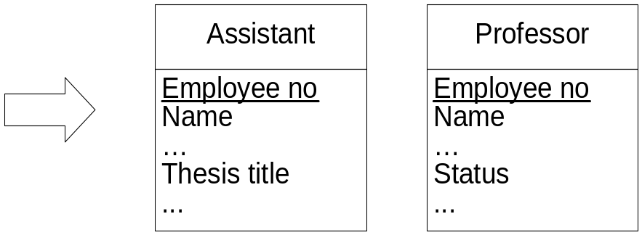
Translating from ER to Relational Schemas
Rule 7 (cont.):
  Only the supertype is associated with a table, which contains also the attributes of the subtype (these are optional attributes)
  Only the subtype is associated with a table containing all attributes of the subtype and the supertype

Slide 23
Defining Relational Schemas in SQL
create table AcademicStaff as (
EmployeeNo integer primary key,
FirstName character varying (30) not null,
LastName character varying (30) not null,
Address character varying (50) not null,
Email character varying (30) not null,
Homepage character varying (64) not null );
create table AcademicStaffResearchArea as (
EmployeeNo integer not null,
ResearchArea character varying (30) not null,
primary key (EmployeeNo,ResearchArea),
foreign key EmployeeNo references AcademicStaff(EmployeeNo) );
…

Slide 24
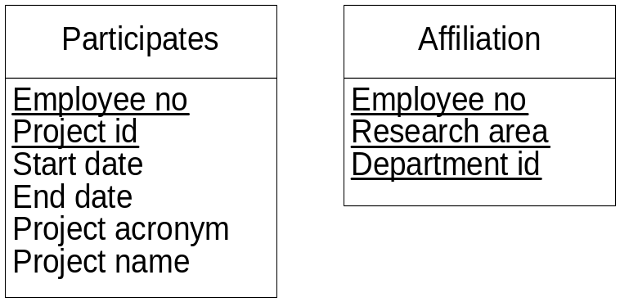
Redundancies and Update Anomalies
Relation with redundancies may induce anomalies in the presence of insertions, updates, and deletions
  In relation Participates the information about a project is repeated for each staff member who works on that project
  In relation Affiliation the information about a research area is repeated for all departments to which the staff member is affiliated
Dependencies and normal forms are used to describe such anomalies

Slide 25
Functional Dependencies
Given a relation R and to sets of attributes X and Y in R, a functional dependency X → Y holds if in all tuples of the relation, each value of X is associated with at most one value of Y
  In Participates above, Project Id → {Project acronym, Project name}
A key is a particular case of a functional dependency
A prime attribute is an attribute that is part of a key
A full functional dependency is a dependency X → Y in which the removal of an attribute from X invalidates the dependency
A dependency X → Z is transitive if there is a set of attributes Y such that X → Y and Y → Z hold

Slide 26
Multivalued Dependencies
Given a relation R and to sets of attributes X and Y in R, a multivalued dependency X →→ Y holds if the value of X determines a set of values for Y, independently of any other attributes
  In Affiliation above, Employee no →→ Research area and
  Employee no →→ Department Id
A multivalued dependency X →→ Y is trivial if either Y ⊆ X or X ∪ Y = R, otherwise it is nontrivial

Slide 27
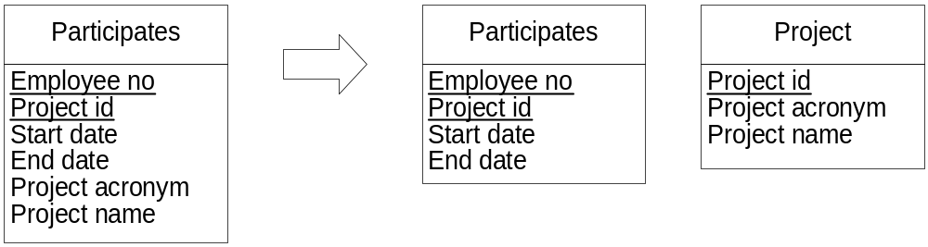
Normal Forms (1)
Normal Form: Integrity constraint certifying that a relation schema satisfies particular properties
In the relational model the relations are in first normal form since all attributes are atomic and monovalues
A relation schema is in the second normal form if every nonprime attribute is functionally dependent on every key

Slide 28
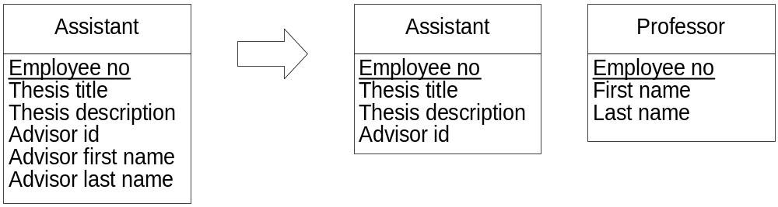
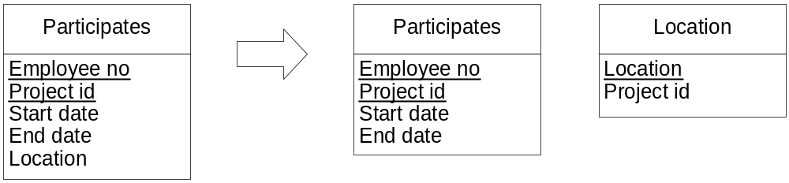
Normal Forms (2)
A relation is in the third normal form if it is in the second normal form and there are no transitive dependencies between a key and a nonprime attribute
A relation is in the Boyce-Codd normal form if for every nontrivial dependency X → Y, X is a key or contains a key

Slide 29
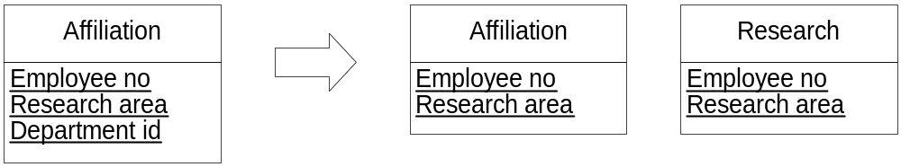
Normal Forms (3)
A relation is in the fourth normal form if for every nontrivial dependency X →→ Y, X is a key or contains a key

Slide 30
Weaknesses of the Relational Model
It provides a very simple data structure, which disallows multivalued and complex attributes
  complex objects are split into several tables ⇒ performance problems
The set of types provided by relational DBMSs is very restrictive (integer, float, string, date, …)
  Insufficient for complex application domains
There is no integration of operations with data structures
It is not possible to directly reference an object by use of a surrogate or a pointer
  links are based on comparison of values ⇒ performance problems

Slide 31
Object-Relational Model: Motivations
Preserves the foundations of the relational model
Organizes data using an object model
  Allow attributes to have complex types ⇒ groups related facts into a single row
Extensions
  Complex and/or multivalued attributes
  User-defined types with associated methods
  System-generated identifiers
  Inheritance among types
Defined in the SQL:1999 and SQL:2003 standards
Current DBMSs (Oracle, …) introduced object-relational extensions, but do not necessarily comply with the standard

Slide 32
Object-Relational Model: Definition (1)
Allow composite types, in addition to predefined types
Complex values may be stored in a column of a table
  Row type: structured values (i.e., composite attributes)
  Array type: variable-sized vectors of values
  Multiset type: Unordered collection of values, with duplicates permitted (bags)
Composite types can be nested
  This is considered an “advanced feature” in the standard

Slide 33
Object-Relational Model: Definition (2)
Two sorts of user-defined types
Distinct types: Represented internally by a predefined type, but cannot be mixed in expressions
  Does not make sense to compare a person’s name and a SSN
Structured user-defined types: ≈ class declarations in OO languages
  May have attributes, which can be of any SQL type
  May have methods, which can be instance or static (class) methods
  Attributes are encapsulated through observer and mutator functions
Both of them can be used as a domain of a column, of an attribute of another type, or a table
Comparison/ordering of values: with user-defined methods

Slide 34
Object-Relational Model: Definition (3)
SQL:2003 supports single inheritance:
  A subtype inherits attributes and methods from its supertype
A subtype can
  Define additional attributes and methods
  Overload inherited methods: provide another definition with a different signature
  Override inherited methods: provide another implementation with a the same signature
Final types: cannot have subtypes
Final methods: cannot be redefined
Instantiable type: includes constructor methods for creating instances

Slide 35
Object-Relational Model: Definition (4)
Two types of tables
Relational tables: usual ones, where domains for attributes are all predefined or user-defined types
Typed tables: defined on structured user-defined types
  Constraints (e.g. keys) defined in the table declaration
  Have a self-referencing column that contains identifiers (surrogates) generated by the DBMS
  Row identifiers can be used for establishing links between tables
Ref type: values are the unique identifiers
  Always associated with a specified structured type

Slide 36
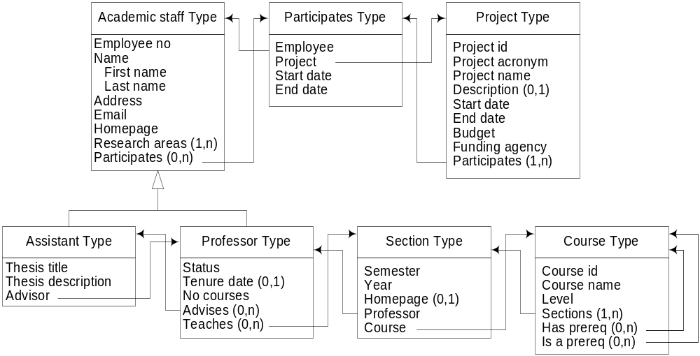
Object-Relational Model: University Example

Slide 37
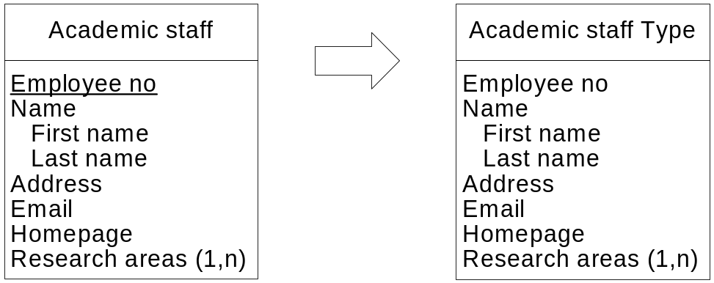
Translating from ER to OR Schemas (1)
Rule 1: A strong entity type is associated with a structured type containing all its attributes
  Multivalued attributes ⇒ defined with the array or the multiset type
  Composite attributes ⇒ defined with the row or the structured type
A table of this structured type must be declared
  Table defines not null constraints for mandatory attributes
  Identifier of the entity type define the primary key of the table

Slide 38
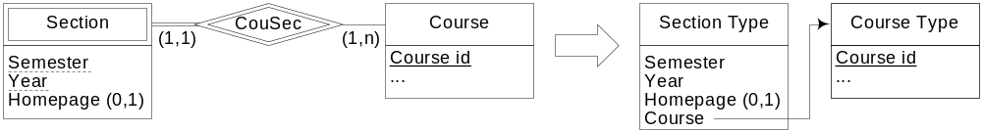
Translating from ER to OR Schemas (2)
Rule 2: A weak entity type is transformed as a strong entity type, but the structured type contains the identifier of its owner

Slide 39
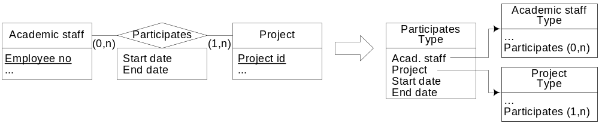
Translating from ER to OR Schemas (3)
Rule 3: A regular relationship type is associated with structured type containing the identifiers of all participating entity types, and all attributes of the relationship
A table of this structured type must be declared
  Table defines not null constraints for mandatory attributes
  Set of identifiers of entity types define the primary key of the table
Inverse references may also be defined

Slide 40
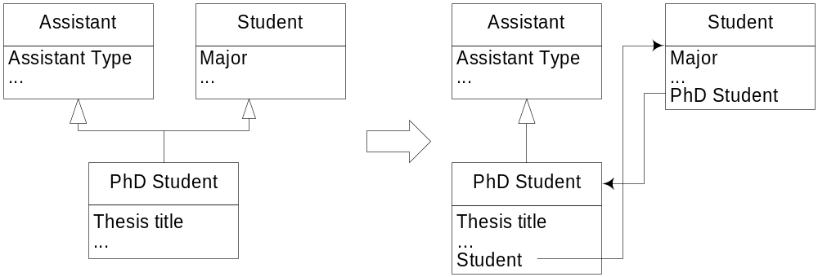
Translating from ER to OR Schemas (4)
Rule 4: Only single inheritance is supported by the model ⇒
multiple inheritance must be removed by transforming some generalization links into binary one-to-one relationships, to which Rule 3 is applied

Slide 41
Defining Object-Relational Schemas in SQL
create type AcademicStaffType as (
EmployeeNo integer,
Name row (
FirstName character varying (30),
LastName character varying (30) ),
Address character varying (50),
Email character varying (30),
Homepage character varying (64),
ResearchAreas character varying (30) multiset,
Participates ref(ParticipatesType) multiset scope Participates
references are checked )
ref is system generated;
create table AcademicStaff of AcademicStaffType (
constraint AcademicStaffPK primary key (EmployeeNo),
Email with options constraint AcademicStaffEmailNN Email not null,
ref is oid system generated );
…

Slide 42
Physical Database Design
Specifies how database records are stored, accessed, and related in order to ensure adequate performance of a database application
Requires to know the specificities of an application, properties of data, and usage patterns
Involves analyzing the transactions/queries that run frequently, that are critical, and the periods of time in which there will be a high demand on the database (peak load)

Slide 43
Performance of Database Applications
Factors for measuring performance of database applications
  Transaction throughput: # transaction processed in a time interval
  Response time: Elapsed time for the completion of a transaction
  Disk storage: Space required to store the database file
A compromise has to be made among these factors
  Space-time trade-off: Reduce time to perform an operation by using more space, and vice versa
  Query-update trade-off: Access to data can be more efficient by imposing some structure upon it
  However the more elaborate the structure, the more time is needed to built it and maintain it when content changes
After initial physical design is done, it is necessary to monitor it and tune it

Slide 44
Data Organization
A database is organized in secondary storage into files, each composed of records, at their turn composed of fields
In a disk, data is stored in disk blocks (pages)
  Set by the operating system during disk formatting
Transfer of data between main memory and disk takes place in units of disk blocks
DBMSs store data on database blocks (pages)
Selection of a database block depends on several issues
  Locking granularity may be at the block level, not the record level
  For disk efficiency, database block size must be equal to or be a multiple of the disk block size

Slide 45
File Organization
Arrangement of data in a file into records and blocks
Heap files (unordered files): Records placed in the file in the order as they are inserted
  Efficient insertions, slow retrieval
Sequential files (ordered files): Records sorted on the values of ordering fields
  Fast retrieval, slow inserting and deleting
Hash files: Use a hash function that calculates the block (bucket) of a record based on one or several fields
  Collision: Bucket is filled and a new record must be inserted
  Fastest retrieval, but collision management degrades performance

Slide 46
Indexes
Additional access structures that speed up retrieval of records in response to search conditions
Provide alternative ways of accessing the records based on the indexing fields on which the index is constructed
Many different types of indexes
  Clustering vs nonclustering: Whether records in the file are physically ordered according to the fields of the index
  Single column vs multiple column, depending on the number of indexing files
  Unique vs nonunique: Whether duplicate values are allowed

Slide 47
Indexes, Clustering
Types of indexes (cont.)
  Sparse or dense: Whether there are index records for all search values
  Single-level vs multilevel: Whether an index is split in several smaller indexes, with an index to these indexes
    Multi-level indexes often implemented by using B-trees of B⁺-trees
Clustering: Tables physically stored together as they share common columns (cluster key) and are often used together
  Improves data retrieval
  Cluster key stored only once ⇒ storage efficiency

Slide 48
Outline
Database Concepts
  Steps in Database Design
  Entity-Relationship Model
  Logical Database Design
    Relational Model
    Object-Relational Model
  Physical Database Design
Data Warehouse Concepts
  Logical Data Warehouse Design
  Physical Data Warehouse Design
  Data Warehouse Architecture

Slide 49
Data Warehouses: Definition (1)
Operational databases (online transaction processing systems or OLTP), are not suitable for data analysis
  Contain detailed data, do not include historical data, perform poorly for complex queries due to normalization
Data warehouses address requirements of decision-making users
A data warehouse is a collection of subject-oriented, integrated, nonvolatile, and time-varying data to support data management decisions
Subject-oriented: focus on particular subjects of analysis (e.g., purchase, inventory, and sales in a retail company)
  Operational databases focus on specific functions of an application

Slide 50
Data Warehouses: Definition (2)
Integrated: Join together data from several operational and external systems ⇒ problems due to differences in data definition and content
  In operational DBs these problems are solved in the design phase
Nonvolatile: Data modification and removal is disallowed ⇒ scope of the data is long period of time
  Operational DBs keep data for a short period of time, as required for daily operations
Time-varying: Keep different values for the same informa-tion and the time when changes to these values occurred
  Operational DBs typically do not have temporal support
Online analytical processing (OLAP): Allows decision-making users to perform interactive analysis of data

Slide 51
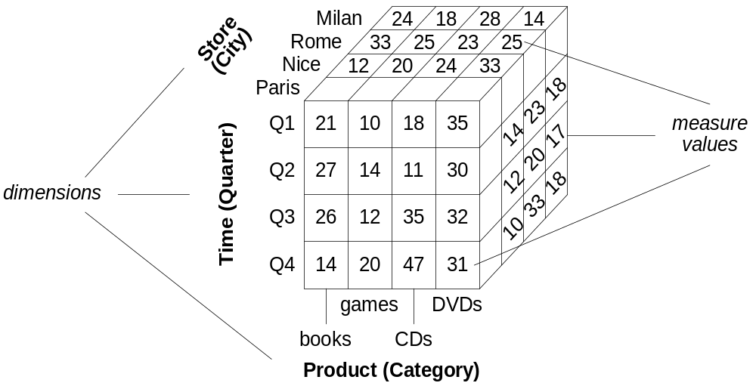
Multidimensional Model
DWs and OLAP use a multidimensional view of data
Represented as a data cube or an hypercube
  Dimensions: Perspectives for analyzing data
  Cells (facts): Contain measures, values that are to be analyzed

Slide 52
Hierarchies
Data granularity: Level of detail of measures
Data analyzed at different granularities (abstraction levels)
Hierarchies relate low-level (detailed) concepts to higher-level (general concepts)
  Example: Store – City – Region/Province – Country
Given two related levels in a hierarchy, lower level is called child, higher level is called parent
Instances of these levels are called members

Slide 53
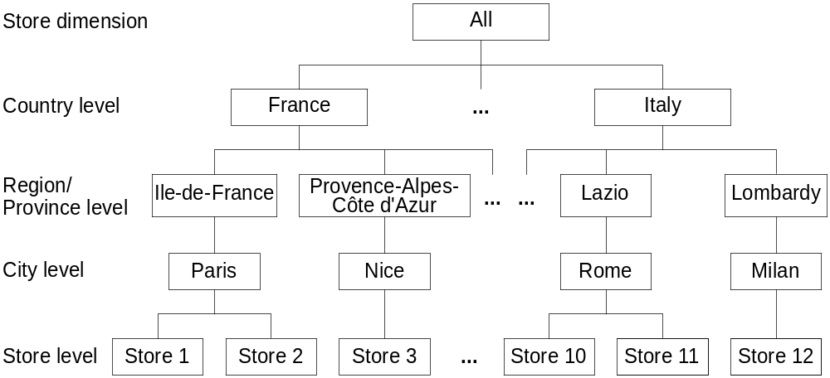
Kinds of Hierarchies
Balanced: Same number of levels from leaf members to root
Noncovering (ragged): Parent of some members does not belong to the level immediately above
  E.g., small countries do not have Region/Province level

Slide 54
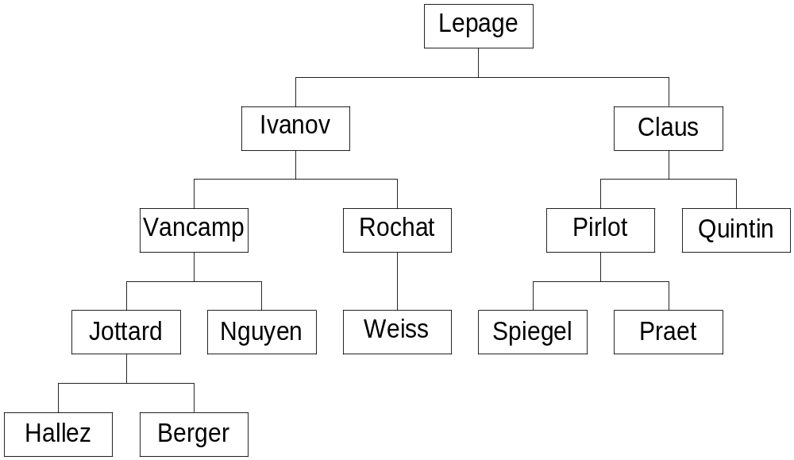
Kinds of Hierarchies
Unbalanced: May not have instances at the lower levels
  E.g., some cities do not have stores, sales are through wholesalers
Parent-child (recursive): Involve twice the same level

Slide 55
Measure Aggregation and Summarizability
Measures are aggregated when using hierarchies for visualizing data at different abstraction levels
Summarizability conditions ensure correct aggregation
  Disjointness of instances: Grouping of instances in a level with respect to the parent in the next level must result in disjoint sets
  Completeness: All instances are included in the hierarchy and each instance is related to one parent in the next level
  Correct use of aggregation functions: Type of measures determine the kind of aggregation functions that can be applied

Slide 56
Measure Classification: Additivity
Additive measures (flow or rate measures): Can be meaningfully summarized using addition along all dimensions
  E.g., sales amount can be summarized when the hierarchies in Store, Time, and Product dimensions are traversed
Semiadditive measures (stock or level measures): Can be meaningfully summarized using addition along some (not all) dimensions
  E.g., inventory quantities, can be aggregated in the Store dimension, but cannot be aggregated in the Time dimension
Nonadditive measures (value-per-unit measures): Cannot be meaningfully summarized using addition along any dimension
  E.g., item price, cost per unit, exchange rate

Slide 57
Measure Classification: Aggregation Complexity
Distributive measures: Defined by an aggregation function that can be computed in a distributed way
  Data is partitioned into n sets, aggregate function applied to each set, aggregated value is computed by applying a function to these n subaggregate values
  E.g., count, sum, min, max
Algebraic measures: Defined by an aggregation function that has a bounded number of arguments, each is obtained by applying a distributive function
  E.g., average, computed from sum and count, which are distributive
Holistic measures: Cannot be computed from other subaggregate values
  E.g., median, mode, rank

Slide 58
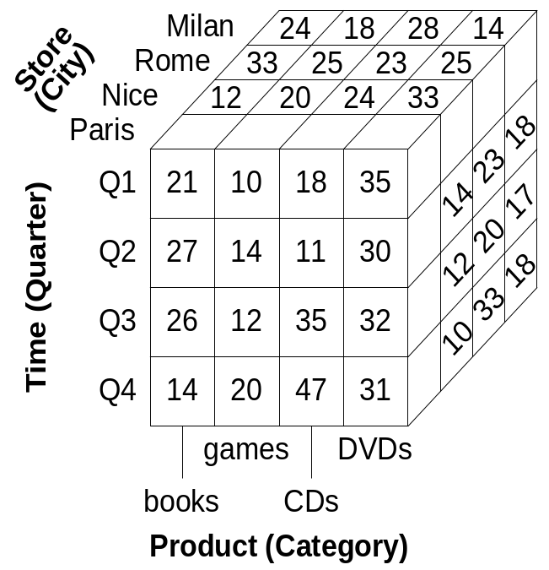
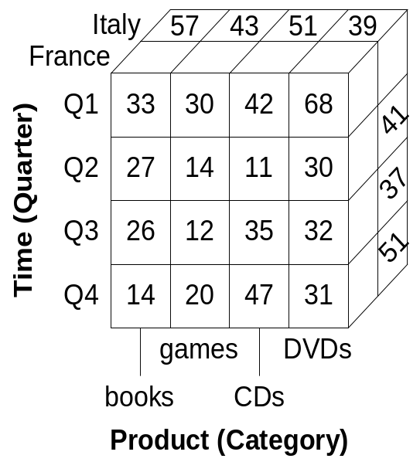
OLAP Operations: Roll up
Transforms detailed measures into summarized ones when one moves up in a hierarchy
Roll-up to the Country level

Slide 59
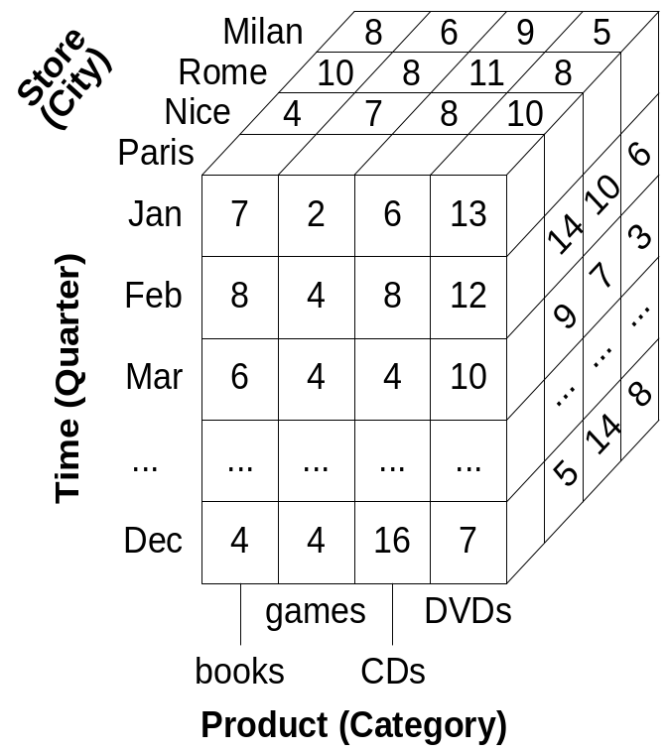
OLAP Operations: Drill down
Opposite to the roll-up operation, i.e., it moves from a more general level to a detailed level in a hierarchy
Drill-down to the
Month level

Slide 60
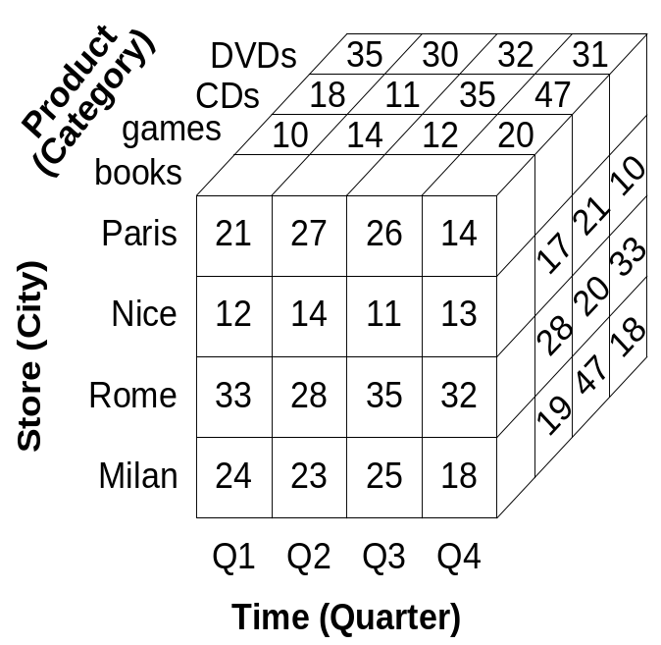
OLAP Operations: Pivot or Rotate
Rotates the axes of a cube to provide an alternative presentation of the data
Pivot

Slide 61
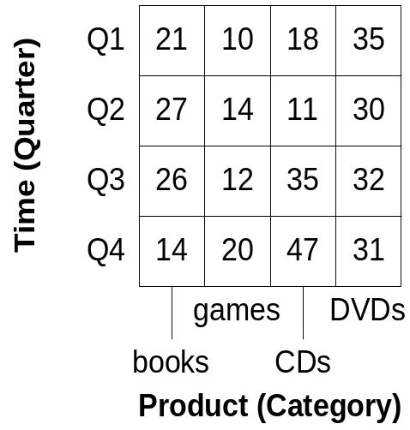
OLAP Operations: Slice
Performs a selection on one dimension of a cube, resulting in a subcube
Slice on Store.City = ‘Paris’

Slide 62
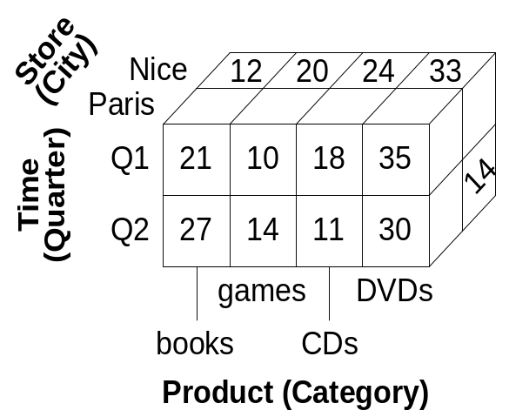
OLAP Operations: Dice
Defines a selection on two or more dimensions, thus again defining a subcube
Dice on Store.Country = ‘France’ and Time.Quarter= ‘Q1’ or ‘Q2’

Slide 63
Other OLAP Operations
Drill-across: Executes queries involving more than one cube, which share at least one dimension
  E.g., compare sales data in a cube with purchasing data in another one
Drill-through: Allows one to move from data at the bottom level in a cube, to data in the operational systems from which the cube was derived
  E.g., for determining the reason for outlier values in a data cube

Slide 64
Implementations of a Multidimensional Model
Relational OLAP (ROLAP): Store data in relational databases, support extensions to SQL and special access methods to efficiently implement the model and its operations
Multidimensional OLAP (MOLAP): Store data in special data structures (e.g., arrays) and implement OLAP operations in these structures
  Better performance than ROLAP for query and aggregation,
  less storage capacity than ROLAP
Hybrid OLAP (HOLAP): Combine both technologies,
  E.g., detailed data stored in relational databases, aggregations kept in a separate MOLAP store

Slide 65
Logical Data Warehouse Design
In ROLAP systems, tables organized in specialized structures
Star schema: One fact table and a set of dimension tables
  Referential integrity constraints between fact table and dimension tables
  Dimension tables may contain redundancy in the presence of hierarchies
Snowflake schema: Avoids redundancy of star schemas by normalizing dimension tables
  Normalized tables optimize storage space, but decrease performance
Starflake schema: Combination of the star and snowflake schemas, some dimensions normalized, other not
Constellation schema: Multiple fact tables that share dimension tables

Slide 66
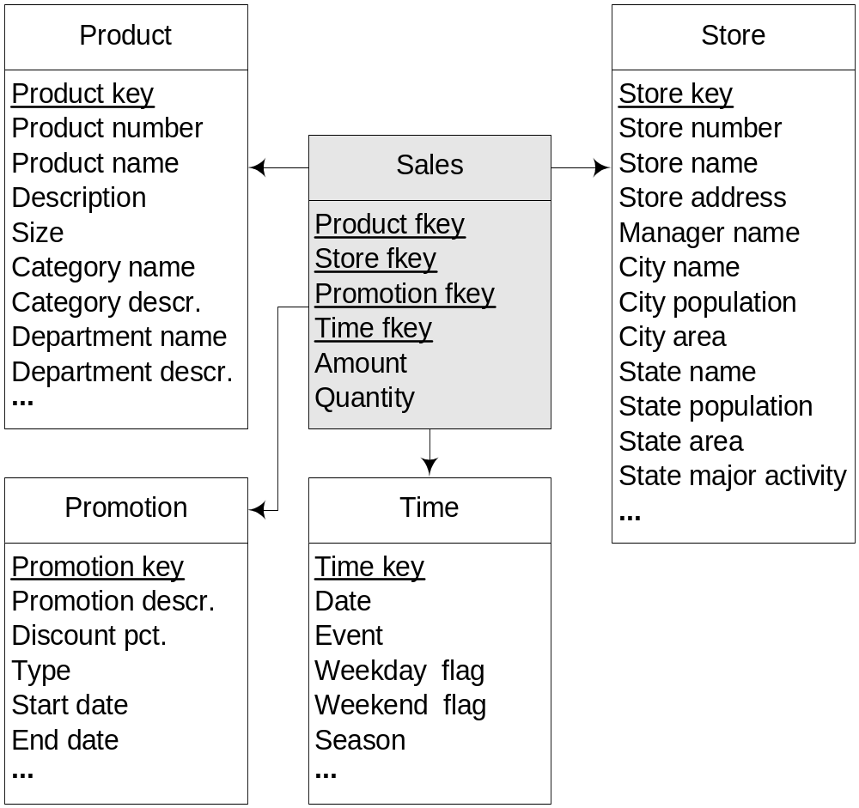
Logical DW Design: Star Schema

Slide 67
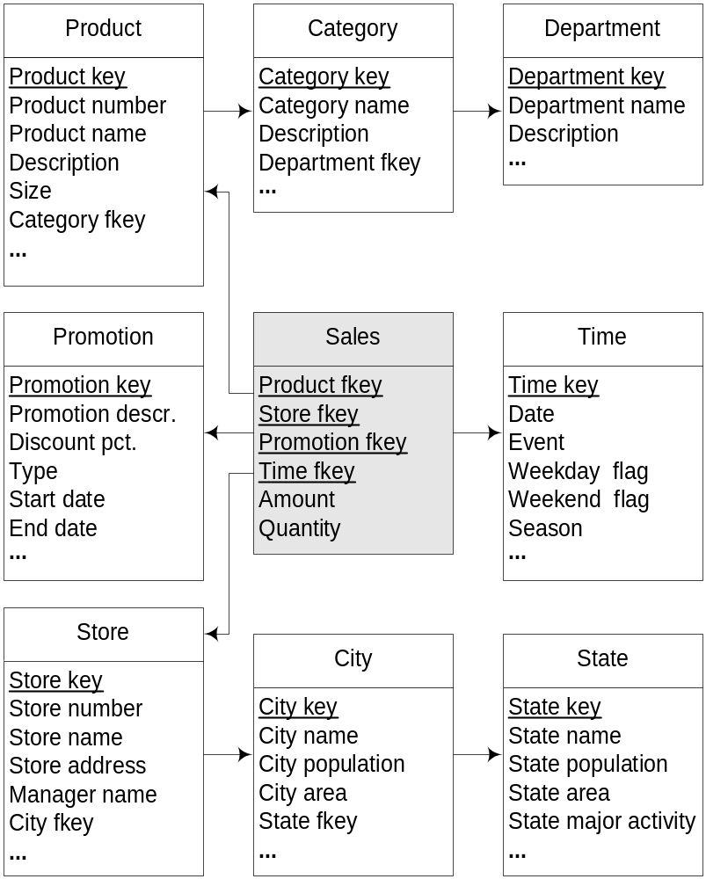
Logical DW Design: Snowflake Schemas

Slide 68
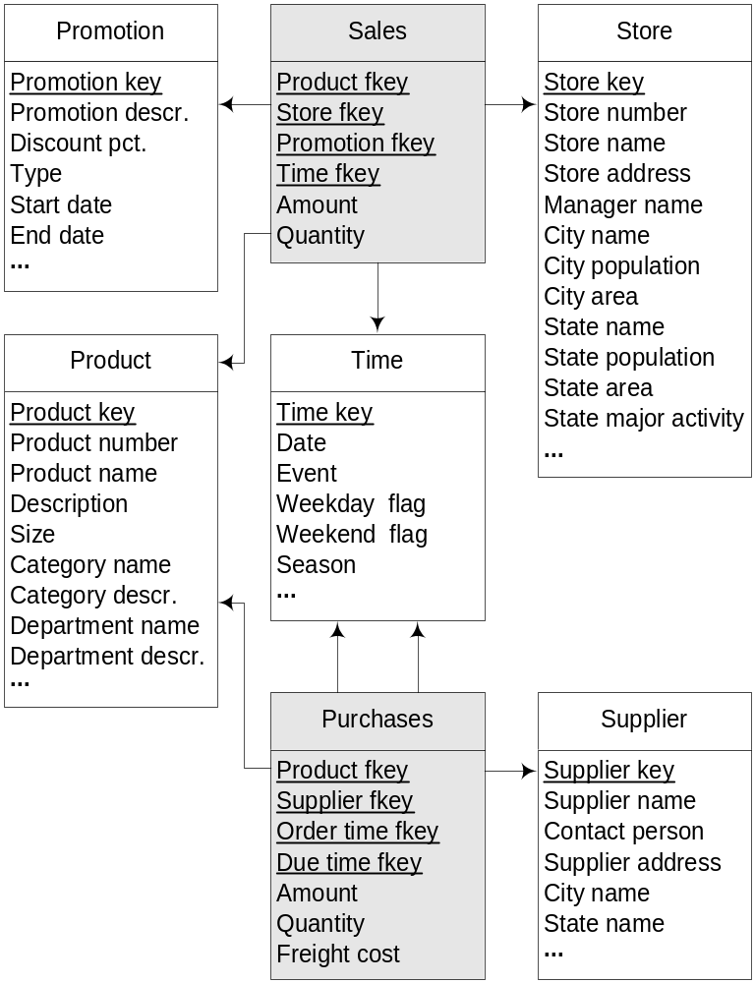
Logical DW Design: Constellation Schemas

Slide 69
Physical Data Warehouse Design: Views (1)
Data warehouses are several orders of magnitude larger than operational database
Physical design is crucial for ensuring adequate response time for complex queries
View: Table derived from a query
  Query may involve base tables or other views
Materialized view : View physically stored in a database
  Enhances query performance by precalculating costly operations
  This is achieved at the expense of storage space
Updating materialized views: Modifications of underlying base tables must be propagated into the view
  Must be performed incrementally to ensure efficiency

Slide 70
Physical Data Warehouse Design: Views (2)
In a DW not all possible aggregations can be materialized
  Number of aggregations grows exponentially with the number of dimensions and hierarchies
Selection of materialized views: Identify the queries to be prioritized, which determines the views to be materialized
DBMSs are providing tools that tune the selection of materialized views given previous queries
Queries must be rewritten in order to best exploit existing materialized views to improve response time
Drawback of materialized view approach: Requires one to anticipate queries to be materialized
  DW queries are often ad hoc and cannot always be anticipated

Slide 71
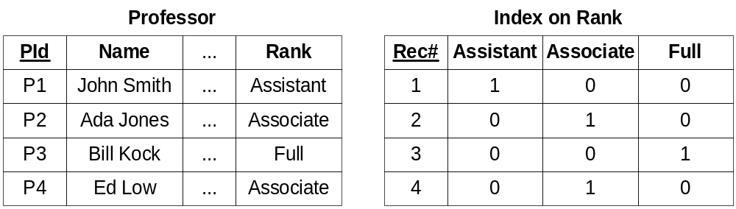
Physical Data Warehouse Design: Indexes (1)
Traditional indexes are not appropriate for data warehouses
  Designed for OLTP transactions that access a small number of tuples
Bitmap indexes: For columns with a low number of distinct values
  Each value is associated with a bit vector whose length is the number of records in the table
  i^{th} bit is set if i^{th} row has that value in the column
Small in size, logical operators used to manipulate them

Slide 72
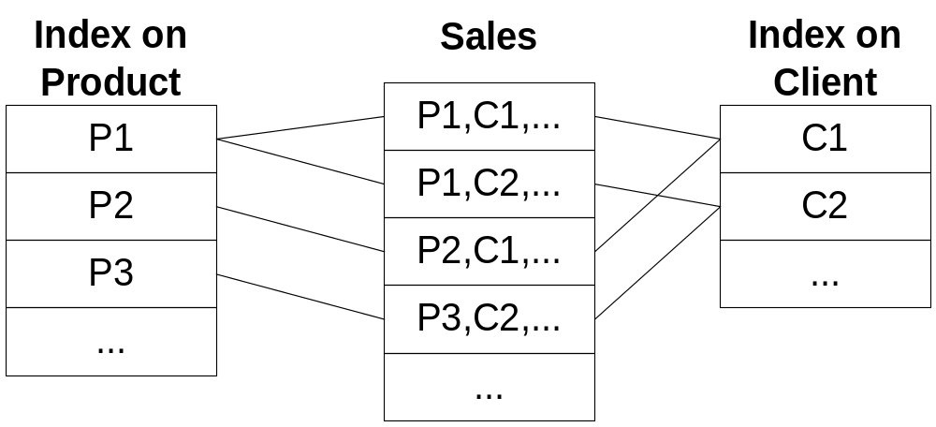
Physical Data Warehouse Design: Indexes (2)
Join indexes: Materialize relational join by keeping pairs of row identifiers that participate in the join
Index selection: Select indexes to minimize execution cost of a series of queries and updates
DBMSs are providing tools to assist DBAs to this task

Slide 73
Fragmentation or Partitioning
Divide the contents of a relation into several files that can be more efficiently processed
Vertical fragmentation: Splits attribute of a table into groups that are stored independently
  E.g., most often used attributes in one partition
Horizontal fragmentation: Divides records of a table into groups according to a particular criterion
  Range partitioning: Partitioned wrt range of values
    E.g., partitioning based on time, each partition contains data about a particular time period (year, month)
  Hash partitioning: Partitioned wrt hash function
  Combined partitioning: Combine these two methods
    E.g., rows first partitioned according to range values, then subdivided using a hash function

Slide 74
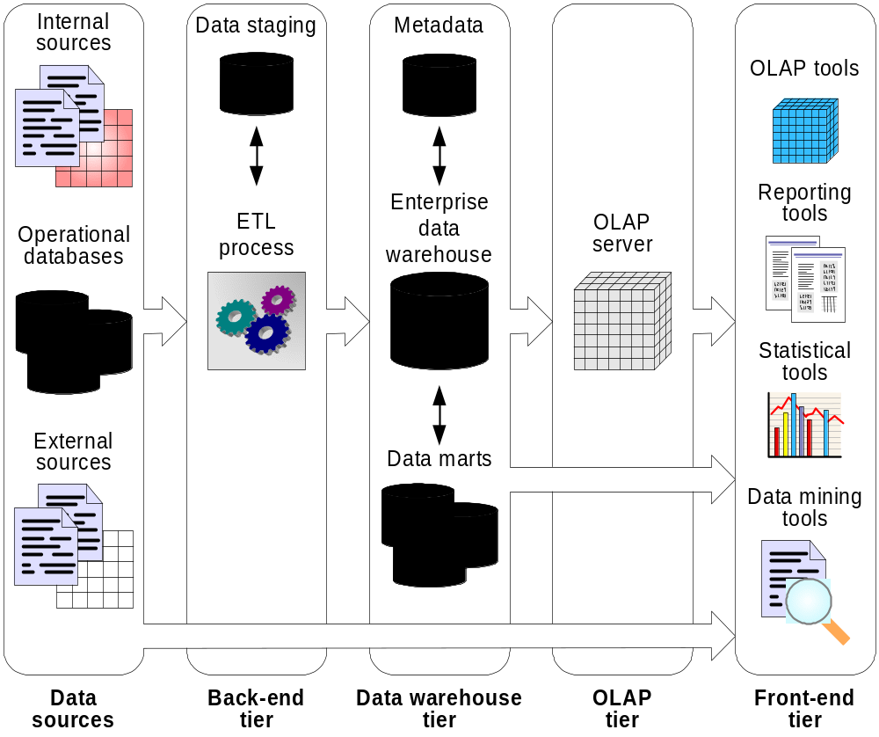
Data Warehouse Architecture (1)

Slide 75
Data Warehouse Architecture (2)
Data sources
  Operational databases
  Other internal or external sources of information (e.g. files)
Back-end tier
  Extraction-Transformation-Loading (ETL) tools for manipulating data from sources
  Data staging area: Intermediate database where manipulation is done
OLAP tier
  OLAP Server: Supports multidimensional data and operations
Front-end tier: Deals with data analysis and visualization
  Composed of OLAP tools, reporting tools, statistical tools, data-mining tools, …

Slide 76
Back-End Tier
Extraction: Gathers data from multiple heterogeneous data sources
  May be operational databases or files in various formats
  May be internal or external to the organization
  Uses APIs such as ODBC, JDBC, … for achieving interoperability
Transformation: Modifies data to conform to the data warehouse format
  Cleaning: Removes errors, inconsistencies, format transformation
  Integration: Reconciles data from different sources
  Aggregation: Summarizes data according to the granularity (level of detail) of the DW
Loading: Feeds the DW with transformed data
  Also includes refreshing the data warehouse at a specified frequency

Slide 77
Data Warehouse Tier
Enterprise data warehouse: Centralized DW that encompasses all areas in an organization
Data mart: Specialized DW targeted to a particular functional area or user group
  Their data can be derived from the enterprise DW or collected from data sources
Metadata repository: Describes the content of the DW
  Business metadata: Meaning (semantics) of data, organization rules, policies, constraints, …
  Technical metadata: How data is structured/stored in the computer
    Data sources, data warehouse, and data marts: logical and physical schemas, security information, monitoring information …
    ETL process: Data lineage (trace to sources), rules, defaults, refresh and purging rules, algorithms for summarization, …

Slide 78
OLAP Tier
OLAP servers that provides multidimensional view from DWs and data marts
  Can be ROLAP, MOLAP, or HOLAP
Most database products provide OLAP extensions and related tools for manipulating cubes
However, no standardized language for querying data cubes
  Oracle uses Java and query language OLAP DML
  SQL Server uses .NET and query language MDX
XMLA (XML for Analysis) aims at providing a common language for exchanging multidimensional data

Slide 79
Front-End Tier
OLAP tools: Allow interactive exploration and manipulation of the warehouse data
  Facilitate formulation of ad hoc queries (no prior knowledge of them)
Reporting tools: Enable production, delivery and management of reports (paper and web-based)
  Use predefined queries
Statistical tools: Used to analyze and visualize the cube data using statistical methods
Data-mining tools: Allow users to analyze data to discover patterns, trends, enable predictions

Slide 80
Variations of the Architecture
Enterprise DW without data marts, or data marts without enterprise DW
  Building enterprise DW is costly, building a data mart is easier
  Integrating independently created data marts is costly
No OLAP server: Client tools access directly DW
Extreme situation: No DW either, client tools access sources
  Virtual DW: Set of materialized views over data sources
  Easier to build, but does not provide a real DW solution
    Does not contain historical data, no centralized metadata, no possibility to clean and transform the data
No data staging area: If the source systems conform very closely to the data in the DW
  Rarely the case in real-world situations

